Slide 1
Extending Copilot in Dynamics 365 Sales using AI Builder & Prompts in Copilot Studio
Vinoth Selvam
March 08, 2025

Slide 2

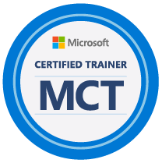


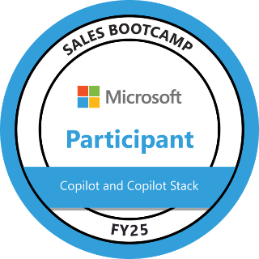
About Me: Vinoth Selvam
12+ years of total experience in IT Industry with major Experience as Microsoft Dynamics 365 CE/CRM Techno-Functional Consultant handling the Functional & Technical aspects in implementation of various Dynamics 365 CE projects across different Industry sectors in Dynamics CE Sales, Service, Field Service and Marketing module.
10+ Years of hands-on Dynamics 365 CE/CRM implementation and Production support experience working on multiple CRM projects across its full life-cycle.
Expertise with Microsoft Power Platform for 5+ years in Power Automate Flow, Power BI, Power Apps.
Recent Experience in Microsoft Copilot and Copilot Studio in building Custom Copilots.
Currently serving as Technical consultant in Avanade, Singapore.

Slide 3
Introduction.
About Copilot Studio.
How to Enable AI features.
AI hub in Power Apps Maker.
Prebuilt AI Prompts.
How to Configure and test your prompt.
Use your prompt actions in Copilot Studio.
Test the Copilot.
Agenda

Slide 4

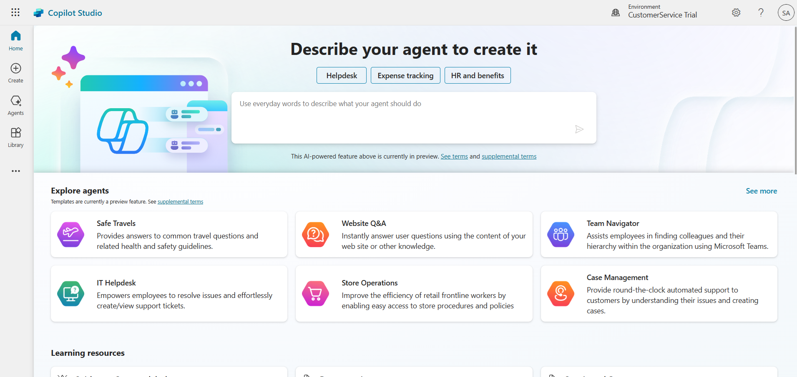
Microsoft Copilot Studio
Copilot Studio is an end-to-end conversational AI platform for extending Microsoft Copilot or building your own copilot Agents with generative AI and large language models

Slide 5

Copilots and Conversational AI
Microsoft 365
Conversational Experiences for M365
Biz Apps & Power Copilots
Conversational Experiences for D365 and Power products
Other Microsoft Copilots
Custom Copilots
Custom copilots and bots for enterprises and third parties
Copilot for Microsoft 365
Custom Enterprise Copilots
Service Copilot
Sales Copilot
Windows Copilot
Microsoft Security Copilot
Copilot for Power Platform
GitHub Copilot
…
Microsoft Copilot Studio Extend and customize 1st party copilots | Build custom Copilots Agents
Bot Framework / SDK
Bot Service Channels
Azure AI Studio
Azure Cognitive Services
Power Platform Connectors
AI Builder

Slide 6
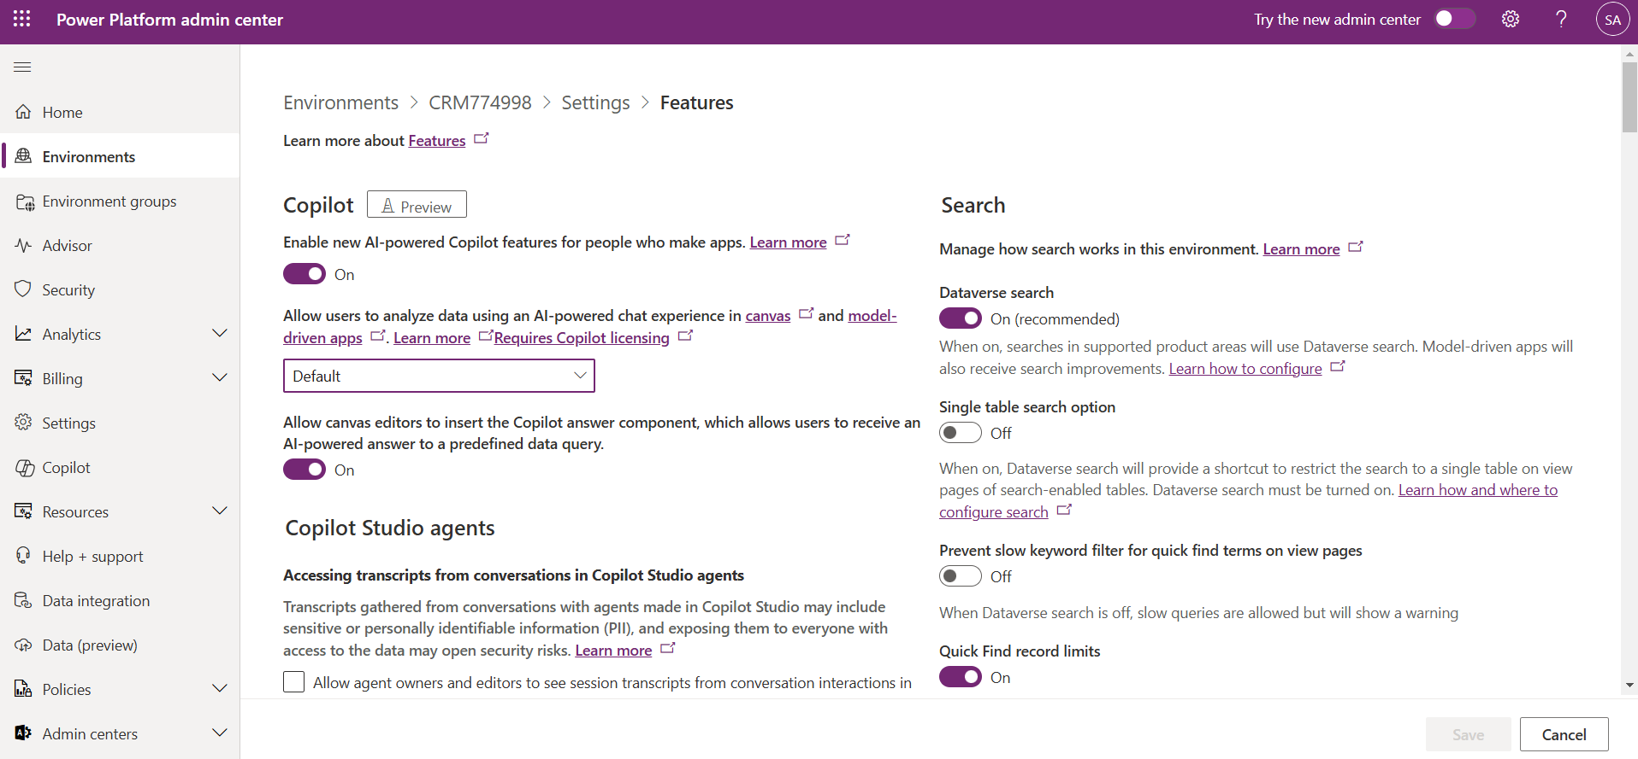
Enable Copilot for model-driven apps in your environment
By default, the AI prompts feature is enabled for makers to create and experiment with various AI-generated content. Admins can enable or disable this feature as needed.

Slide 7
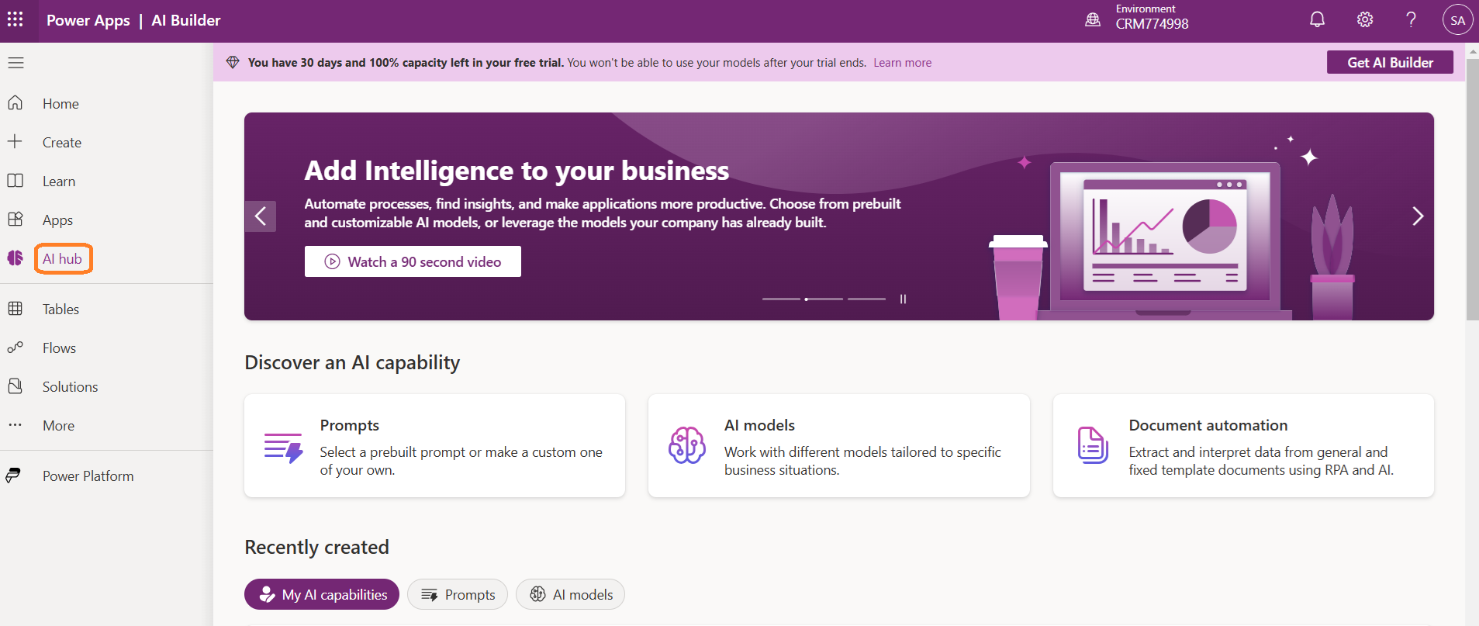
AI hub in Power Apps Maker
Sign in to Power Apps, Power Automate Maker portal.
On the left pane, select AI hub.
Prompt builder provides the flexibility to create your own custom prompt by defining input variables that enable incorporating dynamic runtime content within a prompt.

Slide 8
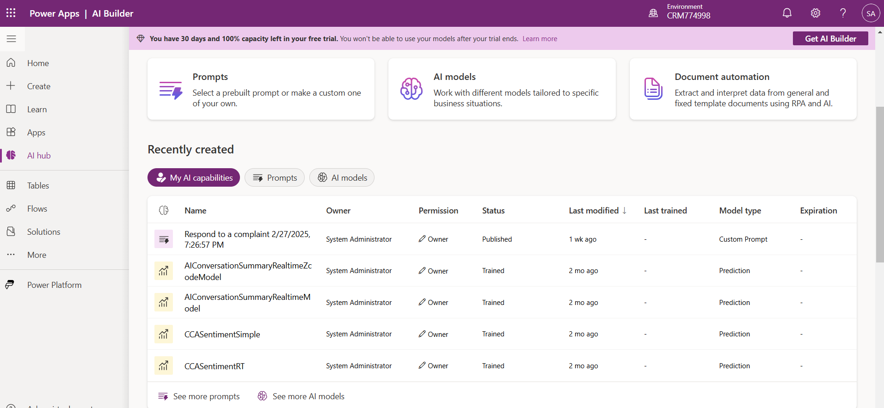
AI hub in Power Apps Maker
You can either use a prebuilt model that is ready for many common business scenarios, or create a custom model that meets your needs. AI Builder helps your business to automate processes and gain insights from your data in Power Apps and Power Automate.

Slide 9
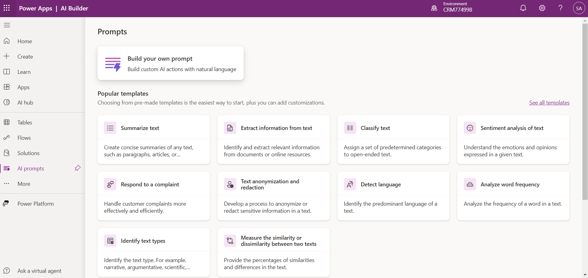
Prebuilt AI Prompts
The Power Platform empowers makers with prebuilt prompts for common business scenarios such as summarizing, classifying, extracting entities, translating, assessing sentiment, or drafting a reply. These prompts allow you to generate AI-driven responses without the need to manually create a prompt.

Slide 10
Create a prompt
Custom prompts give makers the freedom to instruct the GPT model to behave in a certain way or to perform a specific task. By carefully crafting a prompt, you can generate responses that suit your specific business needs. This transforms the GPT model into a flexible tool to accomplish various tasks.
There are generally two parts to a prompt for a GPT model: the instruction and the context.
The instruction is the first part of the prompt. It should provide clear directions on what the GPT model should do.
The context is the second part of the prompt. It should provide the information the GPT model needs to generate an appropriate response.

Slide 11
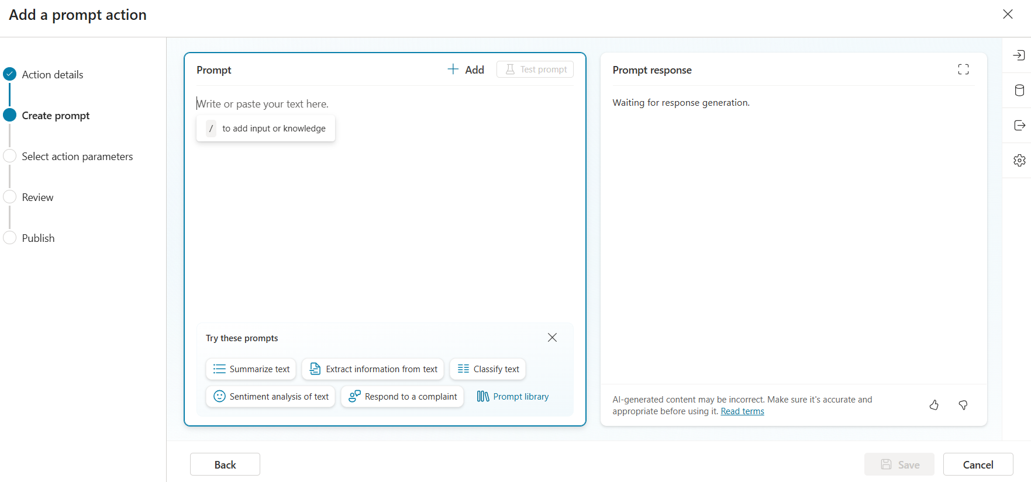
Create a GPT prompt
Prompt builder provides the flexibility to create your own custom prompt by defining input variables that enable incorporating dynamic runtime content within a prompt. It gives you the ability to validate the prompt with Test your prompt, ensuring optimal prompt performance and correctness of the response before integration into your business solutions.

Slide 12
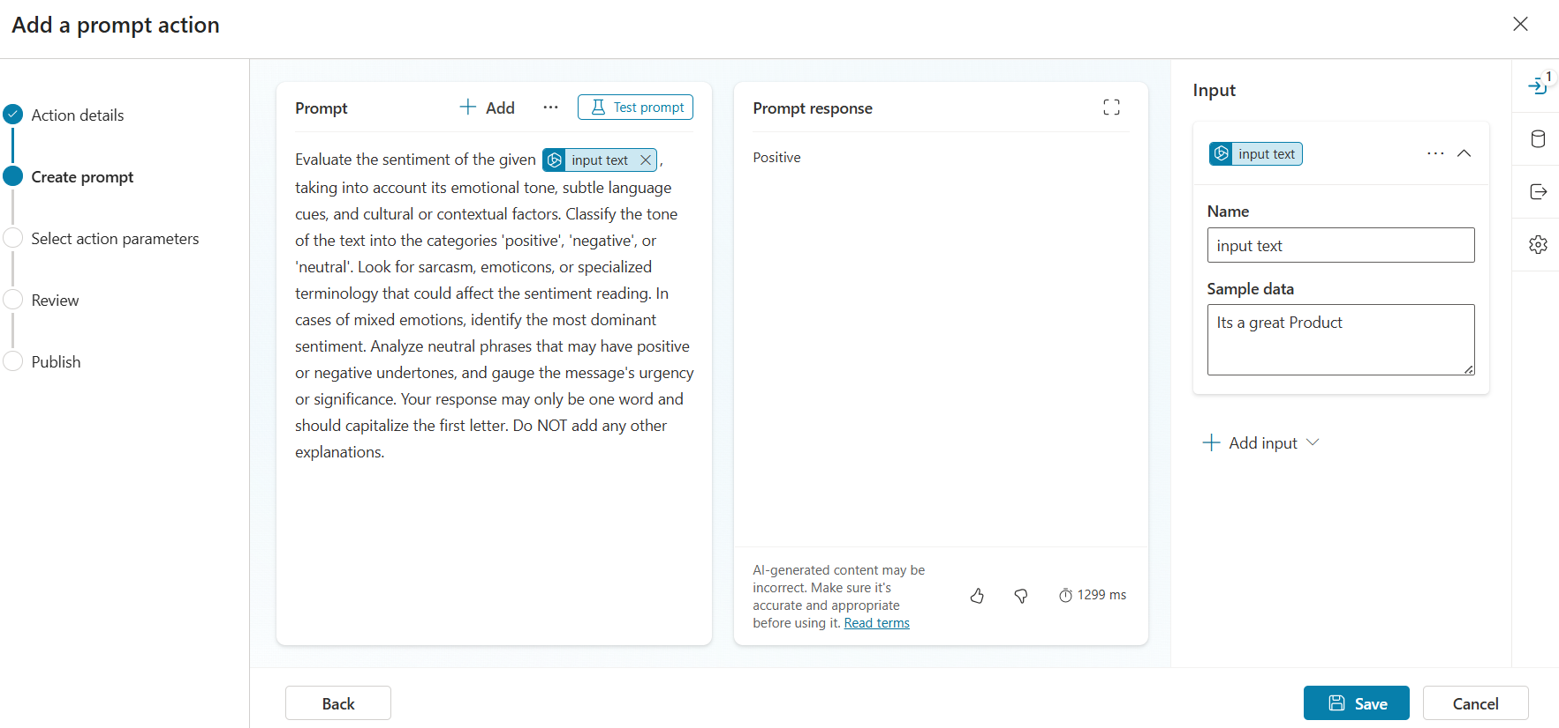
Configure and test your prompt

Slide 13
Use your own data in a prompt
Custom prompts enable makers to use generative AI models addressing various types of content generation scenarios. These models use their default knowledge included in their training data to answer. However, this knowledge isn't sufficient to deal with use cases requiring business specific data context.
Makers can use the Data used option to select one or several Dataverse tables. The fields in these tables are used by the generative model to get more knowledge while answering based on the custom prompt defined and inputs provided.
You can filter the data, which is retrieved by expanding the table and selecting the filtered field and Filter value. The value can be free-form text or an input of the prompt.

Slide 14
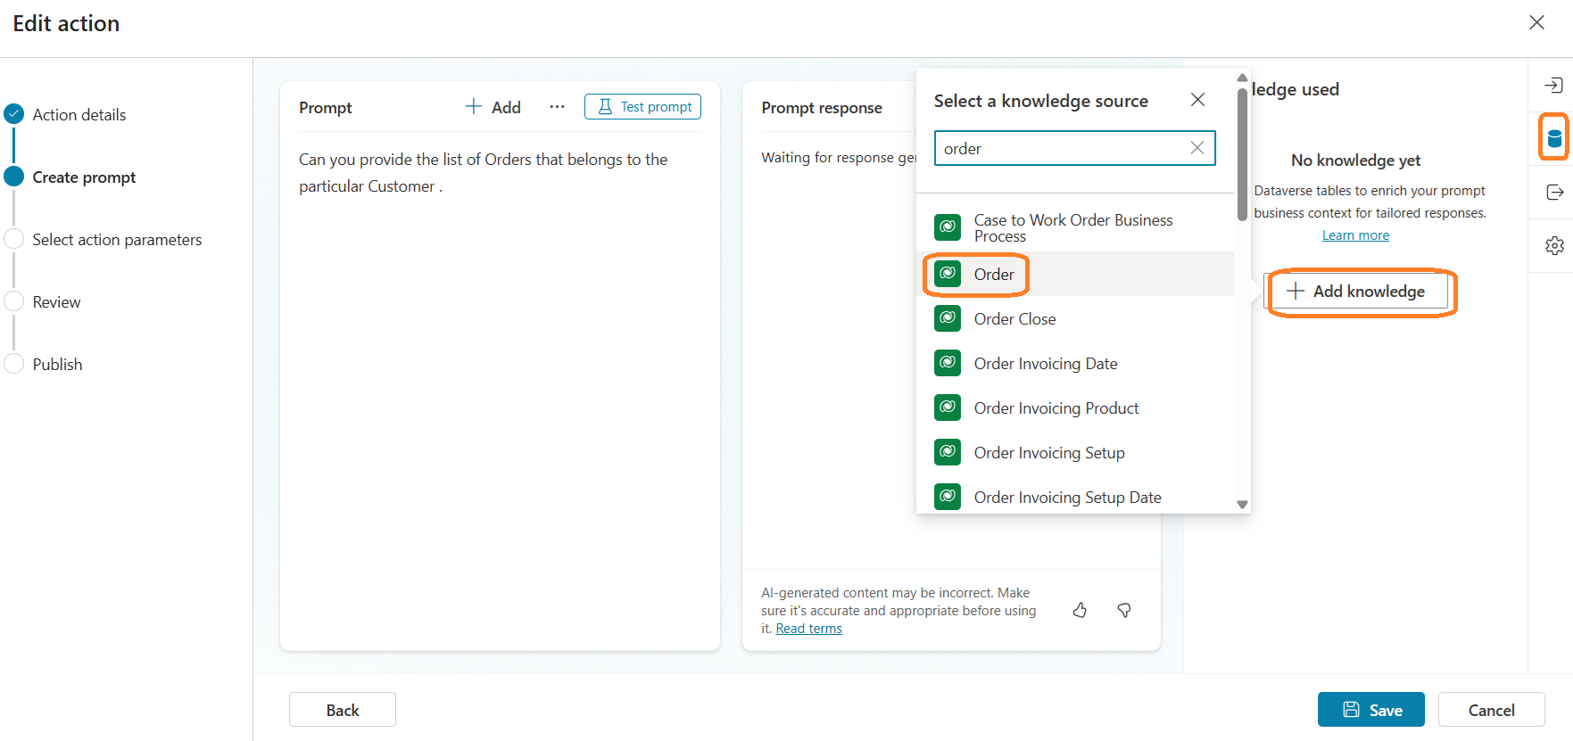
Use your own data in a prompt

Slide 15
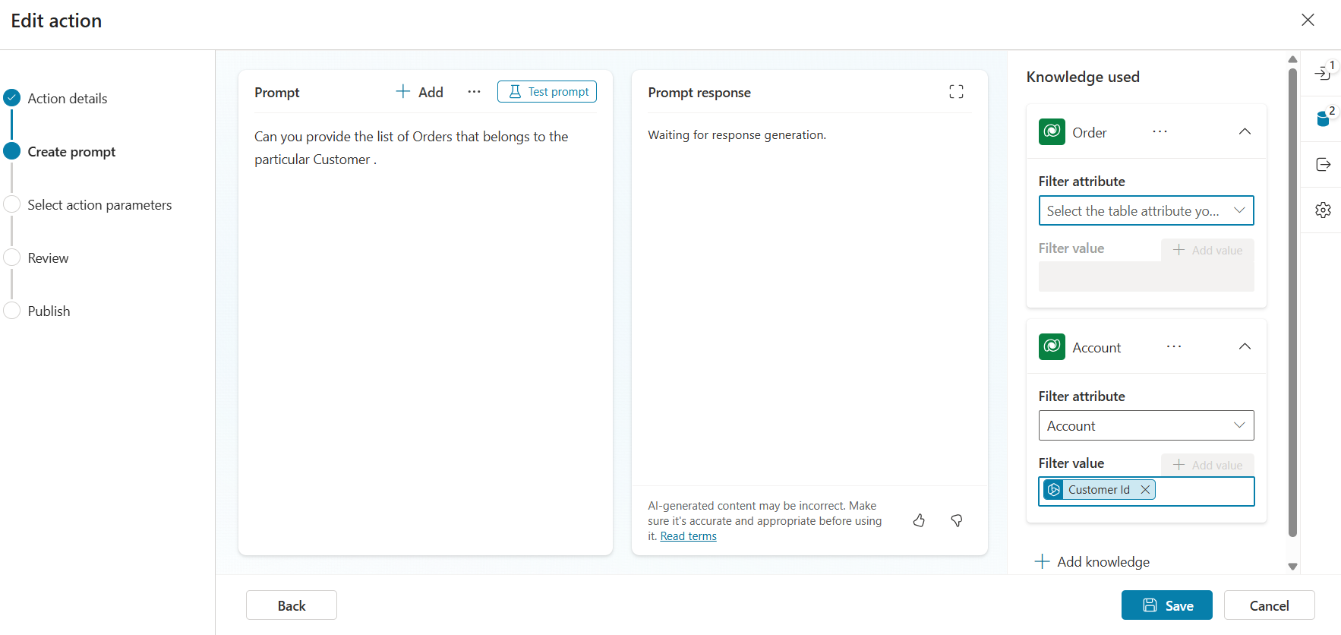
Use your own data in a prompt
You can also insert multiple data and related tables' data references in your prompt and use it with natural language by selecting Insert and navigating through the data and relationships.

Slide 16
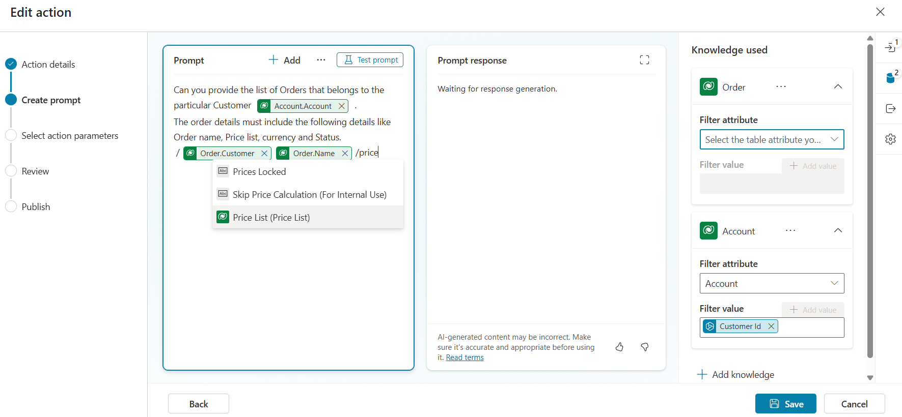
Use your own data in a prompt

Slide 17
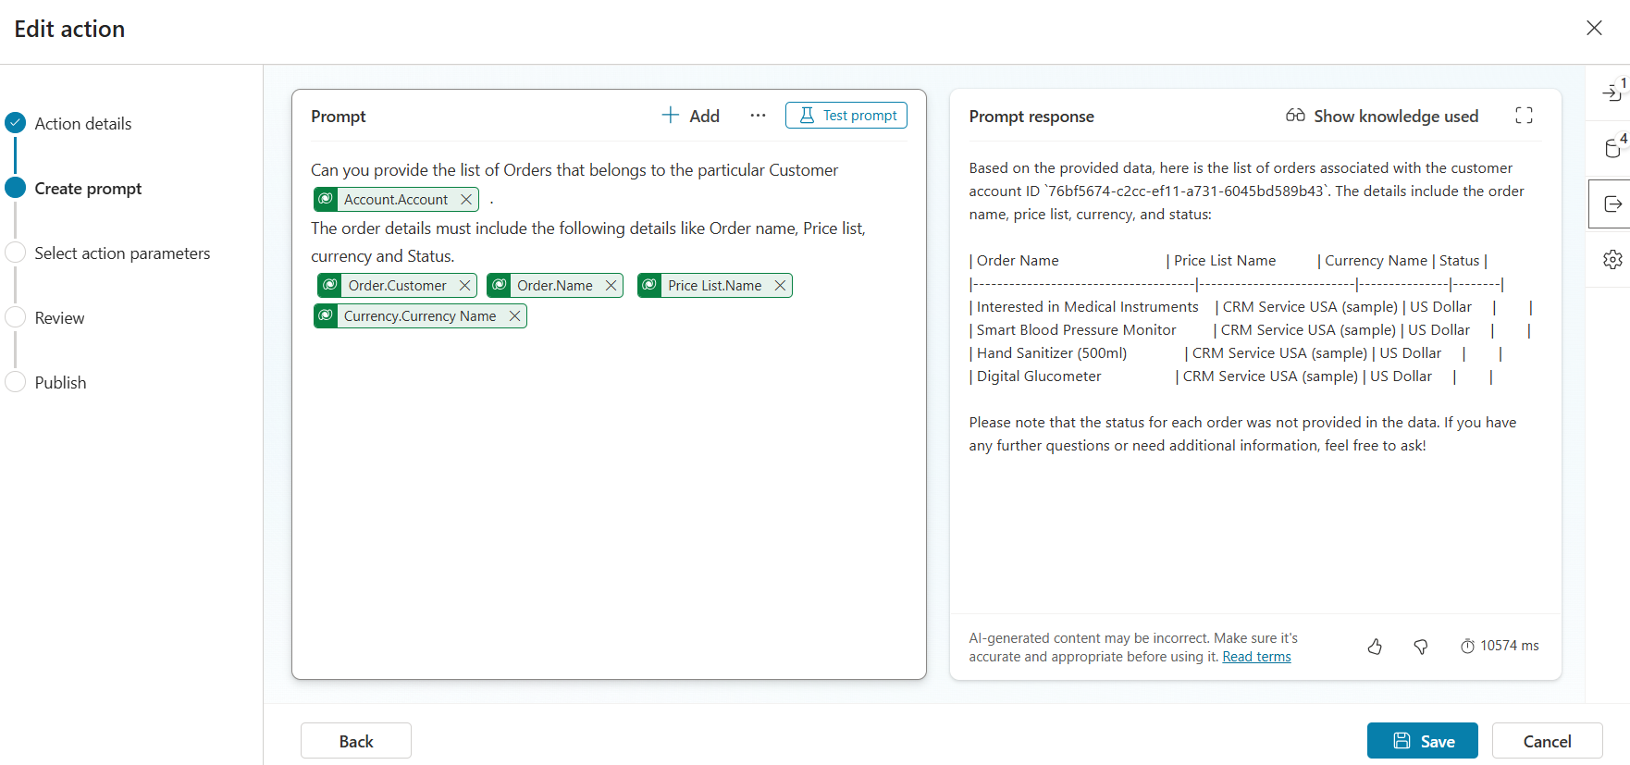
Use your own data in a prompt

Slide 18
Change the output of your prompt
By default, the prompt generates text as response. Text can be convenient for many uses cases. However, if the response has several elements that need to be identified individually, the text option can be limited.
The JSON output allows you to generate a JSON structure for your prompt response instead of a text. JSON allows an easier processing of responses with multiple elements in Power Automate or Power Apps.
To change how the prompt response is rendered, follow these steps:
On the panel to the right under the Prompt settings heading, select Output > JSON.
On the bottom left, select Test prompt to check how your prompt response renders in JSON

Slide 19
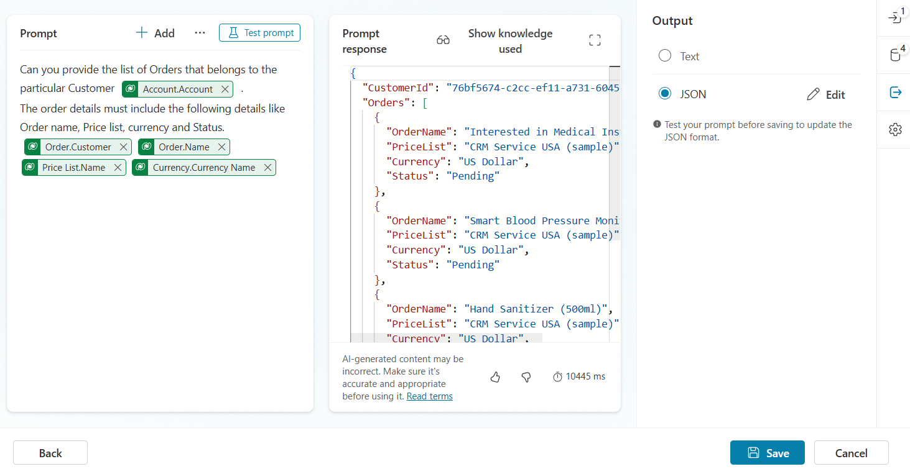
Change the output of your prompt

Slide 20
Use your prompt actions in Copilot Studio
Prompt actions are one of the ways to extend Microsoft Copilots. They do this by creating business specific natural language actions. The actions are interpreted by the GPT model to perform the necessary action as instructed.
These actions are wrapped within a AI plugin definition, which copilots can invoke at runtime when a matching intent or utterance is encountered.
Sign in to Copilot Studio.
From the left navigation menu, select Create New Agent or Open existing Agent.
Navigate to Actions tab..
The Add an action wizard opens.

Slide 21
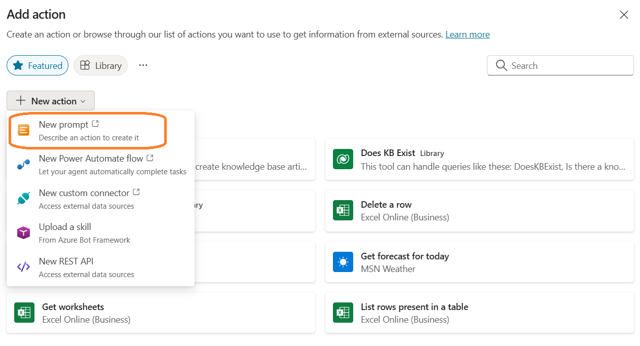
Use your prompt actions in Copilot Studio

Slide 22
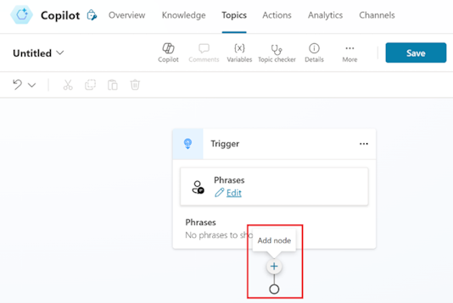
Add a prompt to a topic node
To guide the copilot's responses in a semi-scripted conversation, add a prompt to a topic node. After you create your custom copilot, you can insert a node prompt in a topic.
On the left navigation menu, select Copilots, and then select your custom copilot.
On the menu at the top of the screen, select Topics > Add a topic.
Select From blank > Add node.

Slide 23
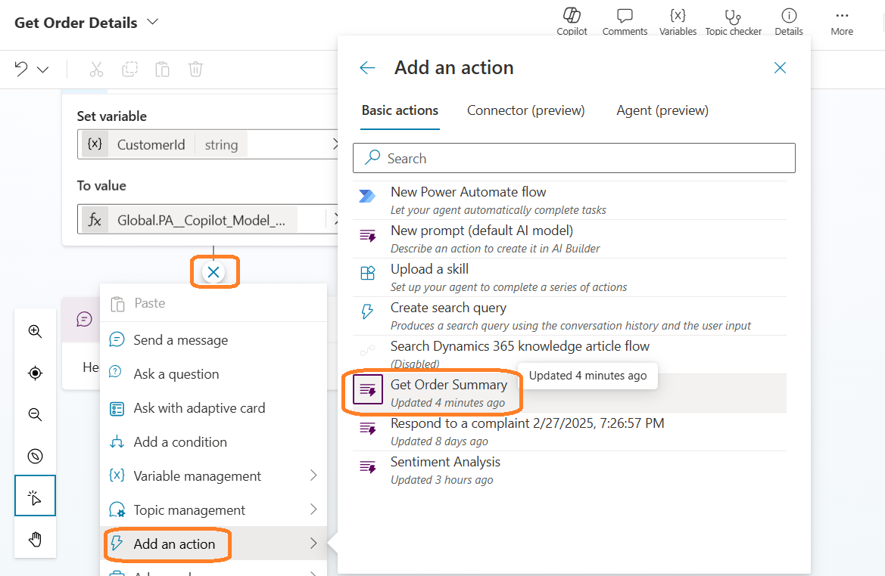
Add a prompt to a topic node

Slide 24
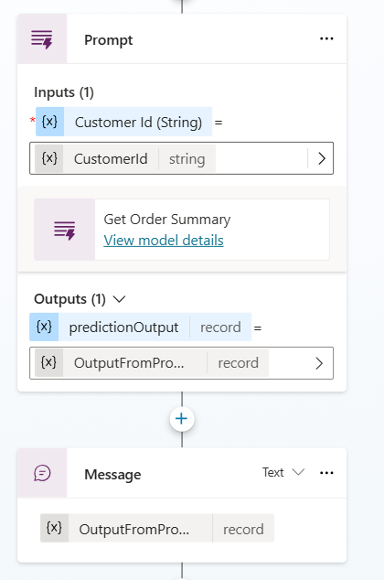
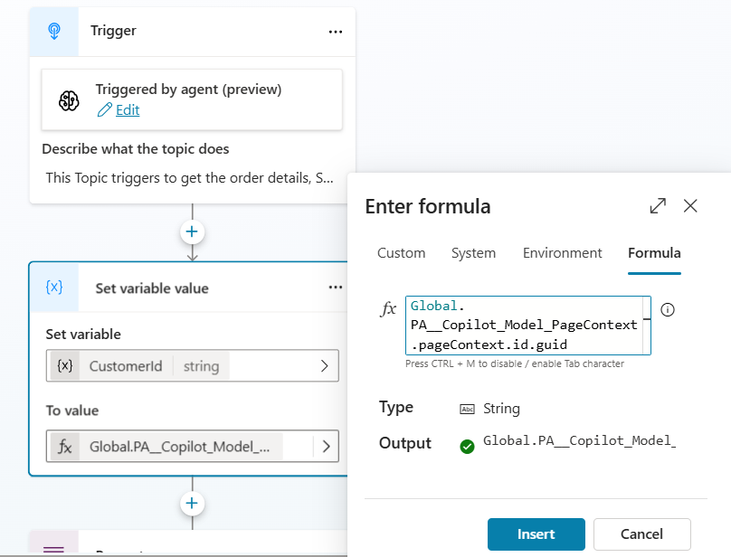
Add a prompt to a topic node

Slide 25
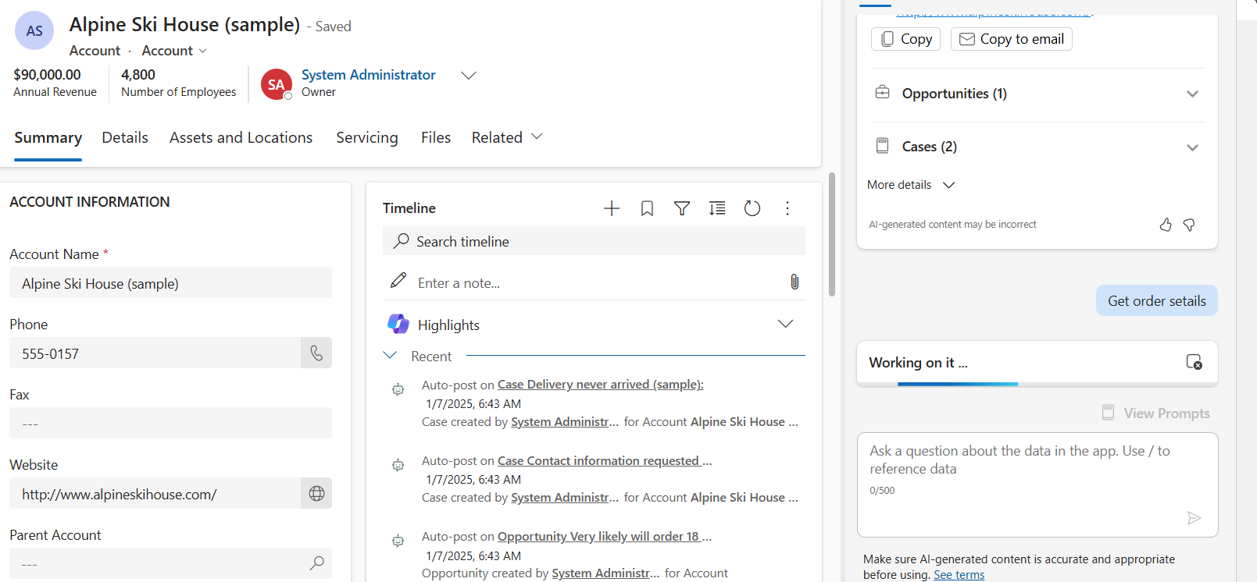
Test the Copilot

Slide 26
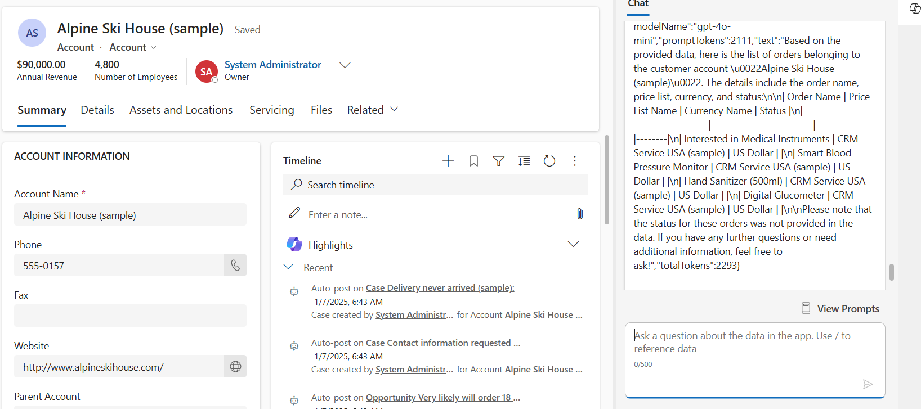
Test the Copilot

Slide 27
References
https://msdcentral.site/co-pilot-studio-introduction-to-ai-builder/
https://msdcentral.site/co-pilot-studio-how-to-use-ai-builder-in-co-pilot/
https://msdcentral.site/co-pilot-studio-how-to-use-ai-builder-integrate-with-dataverse-in-co-pilot/
https://learn.microsoft.com/en-us/ai-builder/prebuilt-prompts
https://learn.microsoft.com/en-us/ai-builder/create-a-custom-prompt
https://learn.microsoft.com/en-us/ai-builder/use-a-custom-prompt-in-mcs
https://learn.microsoft.com/en-us/ai-builder/use-a-custom-prompt-in-flow

Slide 28
Any Questions?

Slide 29
Thank you !!!
Contact Information WhatsApp : (+65) 8872 9718
Website/Blog : https://msdcentral.site/ Email : vinoth_2222@yahoo.com
LinkedIn : www.linkedin.com/in/vinoths2202

